Slide 1

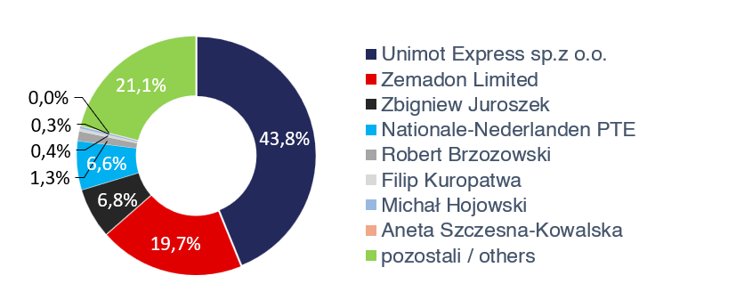

Financial results for Q2 2026
Key events:
A milestone in the natural gas segment – securing access to the LNG FSRU terminal in the Gdańsk area and signing long-term regasification agreements.
Strengthening energy security – joining the LNG Allies organisation supporting the diversification of LNG supplies to Europe.
Development of own RES assets – acquisition of the Gostynin wind farm project with a planned capacity of 34.2 MW and commencement of building an IPP position.
Transformation of energy assets – modernisation of the RCEkoenergia plant through investments in biomass boilers and high-efficiency gas cogeneration.
Development of operations in the defence sector – establishment of cooperation with Ukrainian company JSC “Ivchenko-Progress” in the area of aerospace and defence technologies.
Further diversification and expansion of the Group – focus on developing new business areas and strengthening presence in foreign markets.
Adam Sikorski, Chairman of the Management Board of UNIMOT S.A.
Sales revenue [PLN million]
EBITDA (S) [PLN million]
+17.5%
+32.3%
 | UNIMOT Group |  |  | Q2 2026 – main business segments
[PLN thousand] | Q2 2026 | Q2 2025 | change | Liquid fuels | LPG | Natural gas | Electricity. | PV/RES | Petrol stations | Bitumen | Infra- structure | Solid fuels
Sales revenue | 4 368 287 | 3 717 871 | 17.5% | 2 725 288 | 236 054 | 235 368 | 223 436 | 19 282 | 279 685 | 557 926 | 69 711 | 17 447
Operating profit/(loss) | -95 931 | 36 966 | - | -179 476 | -5 861 | 6 817 | 3 816 | -3 085 | -4 410 | 69 566 | 22 470 | 541
Operating profit margin | -2.2% | 1.0% | -3.2 pp. | -6.6% | -2.5% | 2.9% | 1.7% | -16.0% | -1.6% | 12.5% | 32.2% | 3.1%
EBITDA | -49 539 | 74 031 | - | -173 106 | -2 795 | 7 308 | 3 869 | -2 857 | 892 | 81 111 | 40 641 | 697
EBITDA margin | -1.1% | 2.0% | -3.1 pp. | -6.4% | -1.2% | 3.1% | 1.7% | -14.8% | 0.3% | 14.5% | 58.3% | 4.0%
Adjusted EBITDA | 145 999 | 110 357 | 32.3% | 38 684 | 722 | 7 403 | 3 868 | -3 111 | 1 049 | 67 270 | 38 056 | 646
Adjusted EBITDA margin | 3.3% | 3.0% | +0.3 pp. | 1.4% | 0.3% | 3.1% | 1.7% | -16.1% | 0.4% | 12.1% | 54.6% | 3.7%
Net profit/(loss) | -77 384 | -18 883 | - | -155 208 | -5 054 | 3 552 | 3 127 | -3 253 | -13 986 | 54 385 | 36 889 | 64
Net profit margin | -1.8% | -0.5% | -1.3 pp. | -5.7% | -2.1% | 1.5% | 1.4% | -16.9% | -5.0% | 9.7% | 52.9% | 0.4%
Sales revenue structure
Share in capital of UNIMOT S.A.
Investor contact:
gielda@unimot.pl

